Slide 1


UNDERSTAND & DESCRIBE
A DEEP LEARNING APPROACH TO IMAGE CAPTIONING IN TELUGU
LEELA GUNA KRISHNA KOMPALLI
STUDENT ID: PN990558
JUNE 2022

Slide 2

Introduction
Aims & Objectives
Literature Review
Agenda
Problem Statement
Methodology
Results & Discussion
Conclusion & Future works

Slide 3


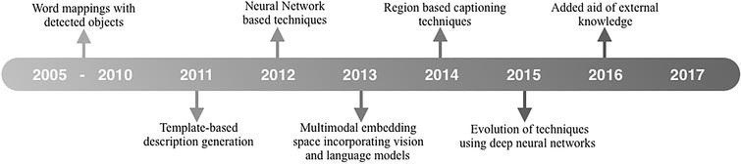
Introduction
Evolution of Image Processing
Evolution of Language Modelling
Evolution of Image Captioning

Slide 4



Aims & Objectives
Using CNNs to learn the image features
Understand an Image
Using RNNs to decode the language and learn the text features
Caption it in Telugu language

Slide 5

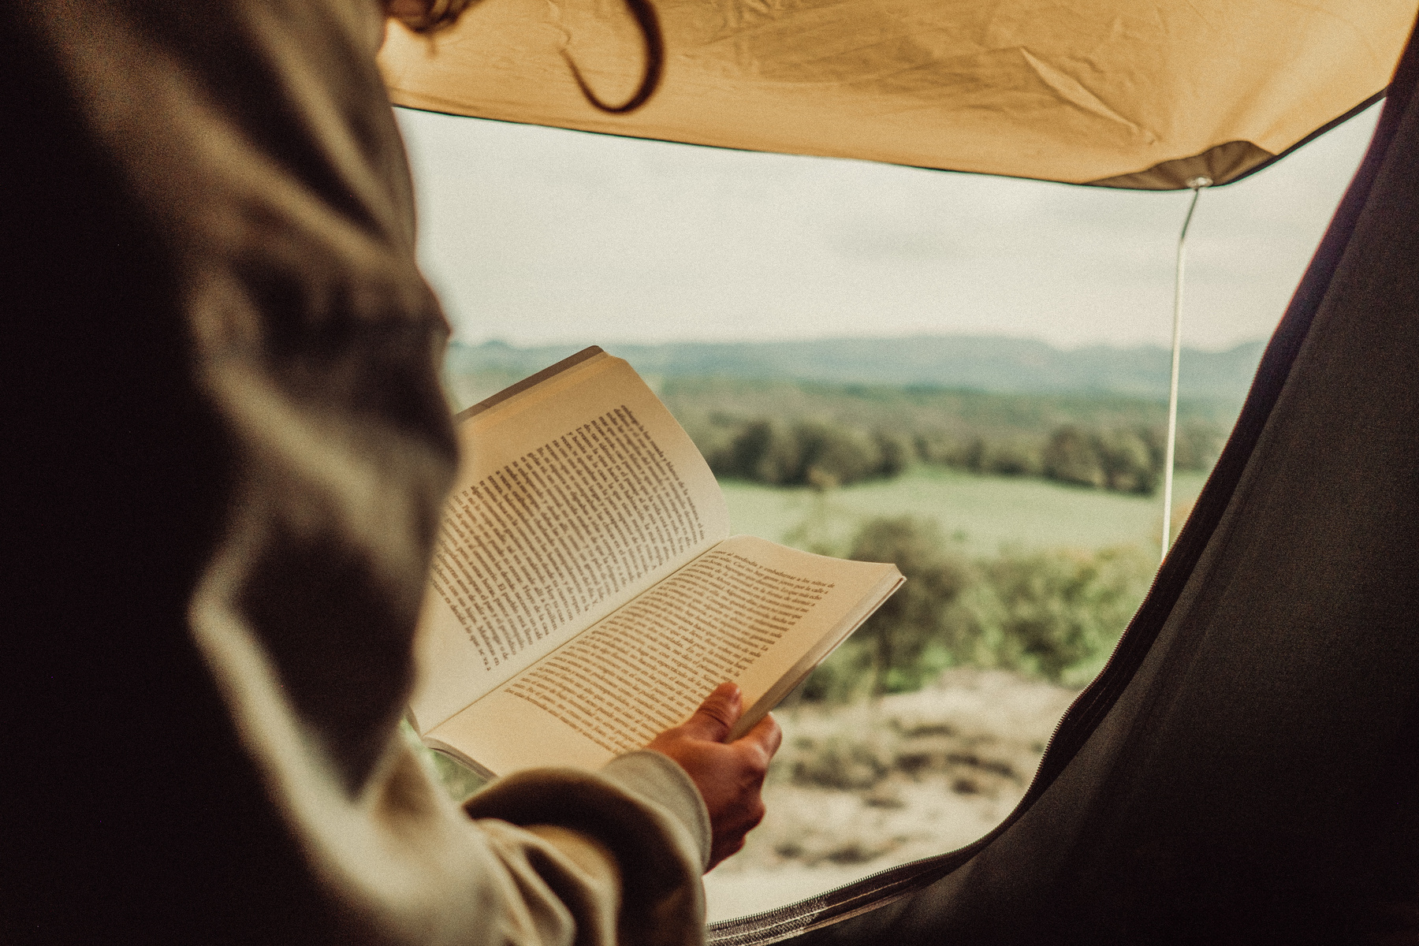
Literature Review
Visual Encoding
Language Modelling
Show and tell: A neural image caption generator
Improvements and challenges in the field of Image Encoding.
Best Practices for the research
Evolution of Recurrent Neural networks
Usage of GRUs, LSTMs, Transformers
Challenges and Achievements in the field of Natural Language Processing

Slide 6

Literature Review
Visual Encoding
Encoding techniques | Challenges and Improvements
Non-attentive using CNNs Methods of incremental attentiveness using Grids Visual connections between visual areas are used in approaches based on graphs. Approaches based on self-attention that use methods based on area, image-to-text, patch/grid which results in paradigms based on engine. | Without the usage of Attention, we can reduce time complexity. Incremental Attentiveness can be a bane. Graphs can lead to unnecessary information gain. Self-Attention is the key

Slide 7
Literature Review
Language Modelling
Decoding techniques | Challenges & Improvements
LSTMs over GRUs Single/Double-Layered LSTMs Transformer models | GRUs memory << LSTMs memory Double-layered is efficient but slower. BERT/Infersent models >> LSTMs

Slide 8
Problem Statement
This research primarily focuses on comparative study of various image captioning techniques in Telugu language. We will understand various visual encoding and language modelling techniques that can be applied to this research. Finally, we will evaluate the model based on various evaluation techniques such as BLEU scores and attain an efficient model for image captioning in Telugu language.

Slide 9
Methodology
Dataset | Encoding | Decoding
Flickr8k with Telugu Annotations | Using pre-trained InceptionV3 CNN architecture | Using Bi-LSTM neural network

Slide 10
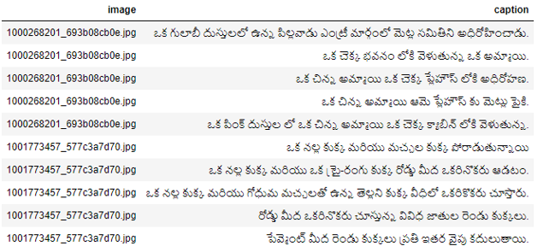
Dataset
The image column shows the label name of the image and the caption shows Telugu captions to the respective images.

Slide 11
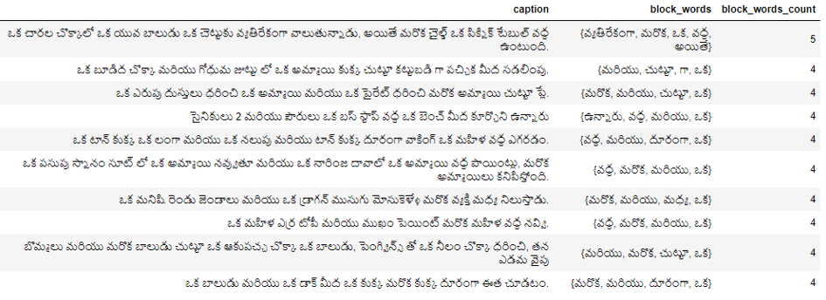

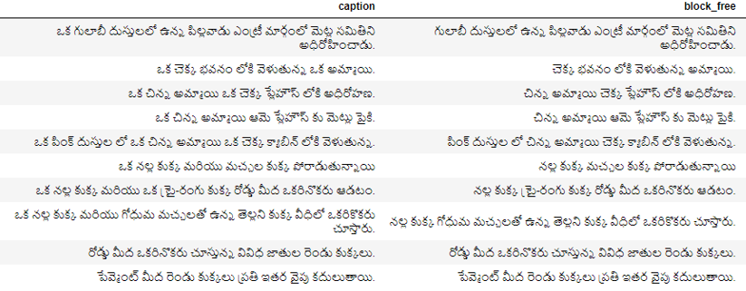
Data Preprocessing
Block words removal & EDA
Block words are found using the stopwords class from NLTK and are removed.
EDA has been implemented and the data is cleaned.

Slide 12
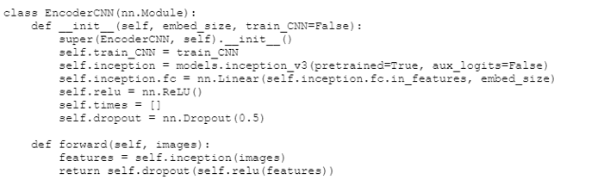
Encoding
Used Inception V3 CNN pre-trained model.
Chose it over resnet50, VGG16.

Slide 13
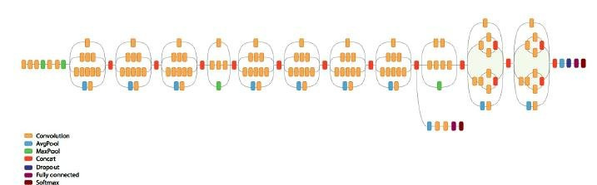
Why InceptionV3?
Top 5 accuracies are better than resnet50 & VGG-16 (94%).
Faster and more efficient.
Fewer parameters - more efficient.
Architecture

Slide 14
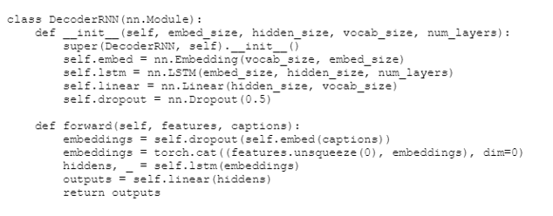
Decoding
Used LSTM network.
Chose it over GRUs and RNNs.

Slide 15
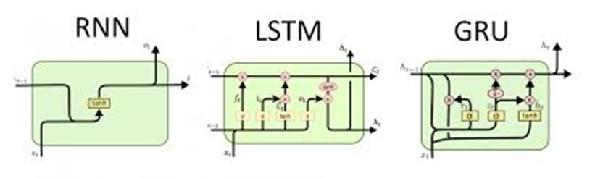
Why LSTMs?
LSTMs performed better when compared to RNNs and GRUs as they have better memory retention.
Faster, lighter and can be combined with another LSTM to provide better results. eg. BERT.
RNN vs LSTM vs GRU

Slide 16
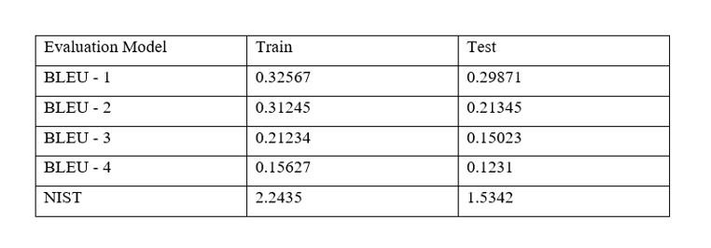
Results & Discussion
~0.3 can be considered as a decent score.

Slide 17
BLEU
Bilingual Evaluation Understudy
It’s the best method and most preferable metric used for evaluating translations in machines.
Despite the fact that the model is not a translation model, the output captions are compared to the original human-written captions of every given picture
Scale 0 to 1

Slide 18
NIST
US National Institute of Standards and Technology
It is an altered BLEU metric that adds mass to n-gram.
NIST score metric ran on fifty random trains and test images individually. Because no reliable sources for comprehending the NIST metrics have been identified, BLEU is often employed.

Slide 19



Conclusion & Future Works
The project has shown that the usage of forthright approach, there is a possibility for designing captions for images model especially for the Indian Languages. It acquired really fair enough in an Indian language. This project helps to predict caption which is word after word with input of an image.We also advocate combining the investigated word embeddings with other NLP tasks such as Named Entity Identification (NEI), POS tagging, and Question Answering System (Q&A). These pre-trained embeddings may then be used in unsupervised tasks like information retrieval and extraction where we have minimal data.

Slide 20

Thank you!

